Slide 1
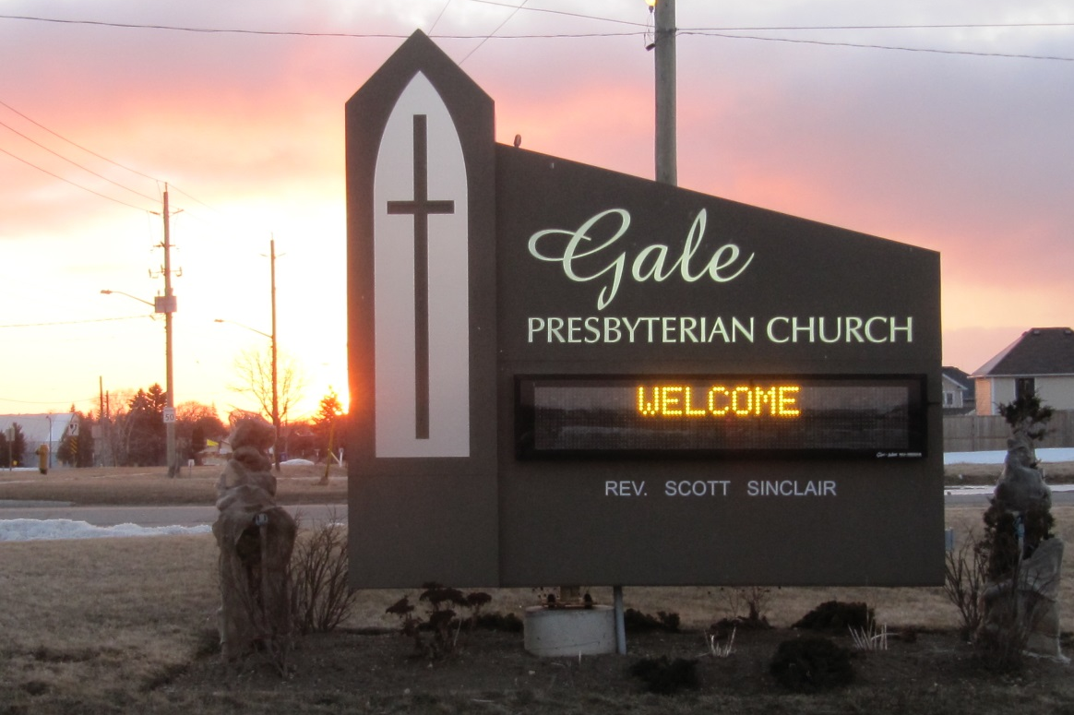
Welcome to
Gale PRESBYTERIAN CHURCH
June 14th, 2015

Slide 2
THIS WEEK AT Gale
Tuesday June 16th
Tuesday Luncheon – 11:30am-1 p.m.
Prayer Group – 7:30 p.m.
HR Committee Meeting – 1 p.m.
Wednesday, June 17th
Congregational Meeting – 7 p.m.

Slide 3
THIS WEEK AT Gale
Thursday, June 18th
Session Meeting – 7 p.m.
Saturday, June 20th
Men’s Breakfast – 8:30-10 a.m.

Slide 4
COMING SUNDAYS AT Gale
June 21st – Sunday School Graduation and Special Recognitions
July 5th – Worship time changes to 10:00 a.m.

Slide 5
Wednesday, July 1 - Church Office will be closed.
Effective Thursday, July 2 through to
Tuesday, September 8 the Church Office hours will be 9 a.m.- Noon, Monday through Friday.

Slide 6
FOOD BANK
Items for the month of
June are:
Shampoo
Cookies

Slide 7
Kintail on the Road returns once again to Gale !
Mark the week of Monday August 24 to Friday August 28 and plan to have your children join us.
This year’s theme: “No Matter What!”
Registration forms are now available in the church office or online.

Slide 8
REGISTRATION IS OPEN TO ANYONE
Drop off all completed registration forms at the church office.
We have limited spots available so sign up soon!

Slide 9
At the request of the Board of Managers the
Session of Gale Presbyterian Church has called for a Congregational Meeting to be held
June 17th at 7:00 p.m. in the Sanctuary.
The purpose of this meeting is to discuss a project to install solar panels on the church and to authorize the use of trust funds for this project.
All participants in the Gale ministry are invited to attend.

Slide 10
SHOWERS OF HAPPINESS
Laura Kendall is getting married this summer!
John & Sandy will be travelling to Muskoka for their daughter’s wedding!
As it is difficult for Laura to get to Elmira for a “Bridal Shower” at Gale, we are instead going to send our showers of good wishes and a gift card from her friends here to her home in Vancouver. (Gift Cards travel a little easier!)
Your contribution for Laura’s gift card can be given to Carol MacIntyre, Wendy in the church office or it can also be left with Karen Pond at the gift card table no later than July 5th..
We are so happy to give Laura and Scott our best wishes and prayers for God’s blessings as they make this important commitment in their lives.

Slide 11
Volunteers Needed for Kintail on the Road August 24th-August 28th
Though summer is just about to begin it is already time to get excited about Kintail on the Road in August.
To make this week happen we need you…our amazing volunteers!
Come play with kids, eat snacks, sing songs and have fun! The volunteer sign-up list is on the KOTR board in the narthex.
Busy the last week of August? We could use craft supplies and decorations. Check out the supplies list on the KOTR board.
We have a few spots open. If you know a child who would be interested in attending, please direct them to the Gale Presbyterian website where they can find more information and the registration forms.

Slide 12
Saturday, June 20th
8:30 – 10 a.m.
Hosts: Kees and Darlene Vandermey
Please sign up on sign up sheet in foyer.

Slide 13
To everyone who donated clothes hangers and jam jars.
The Life and Mission Team is very grateful for your help in future projects.

Slide 14
VBS August 24-28
We provide snacks.
Can you Help?
Sign up sheets are in the foyer.
Every little bit helps!

